Slide 1
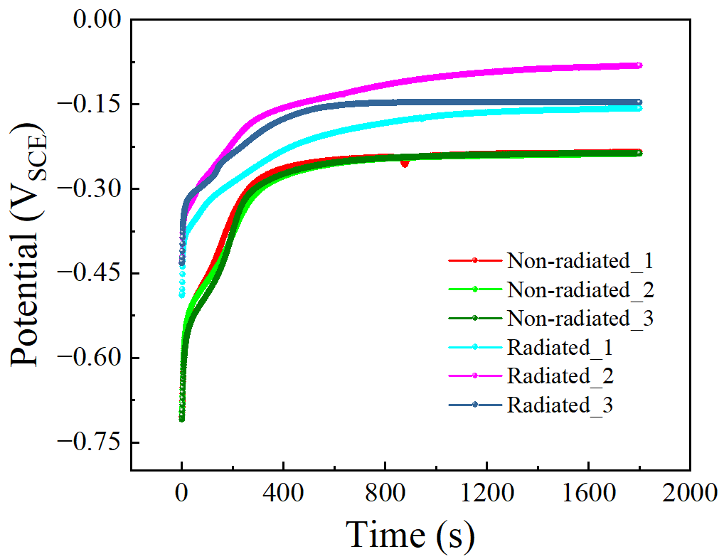
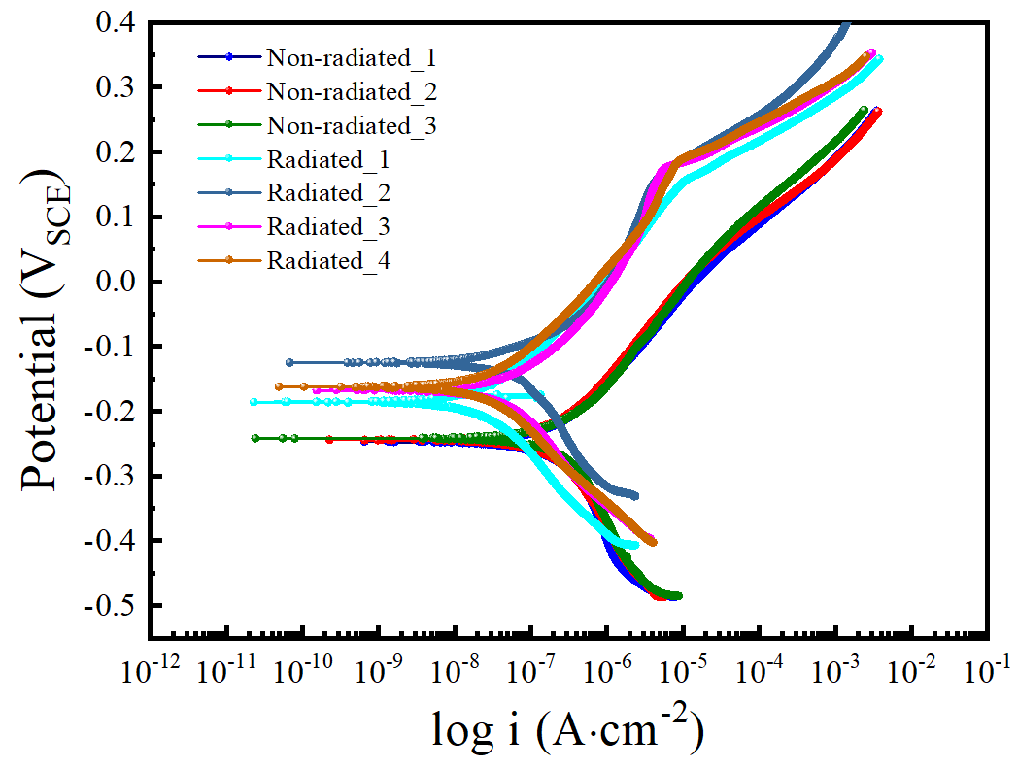
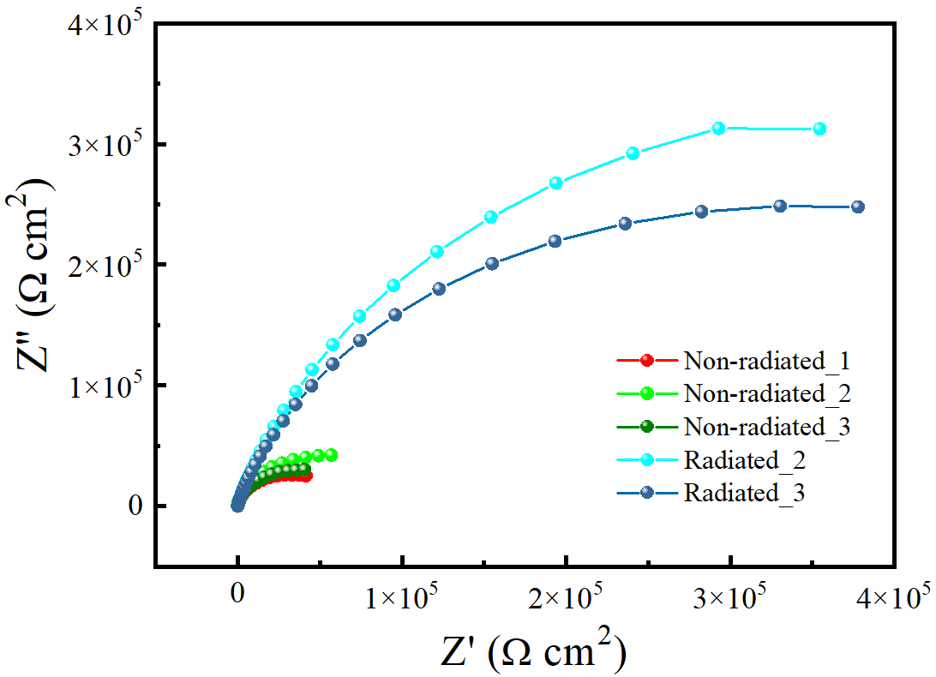
Supplementary materials

Slide 2
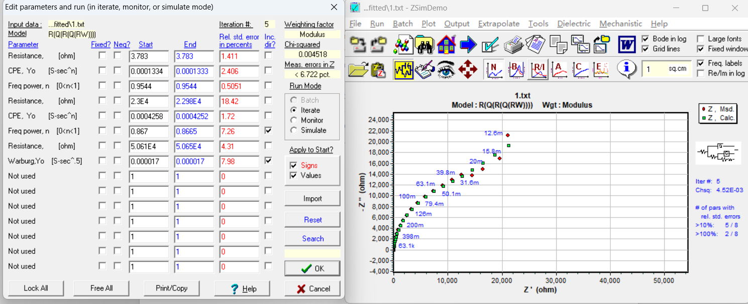

Slide 3
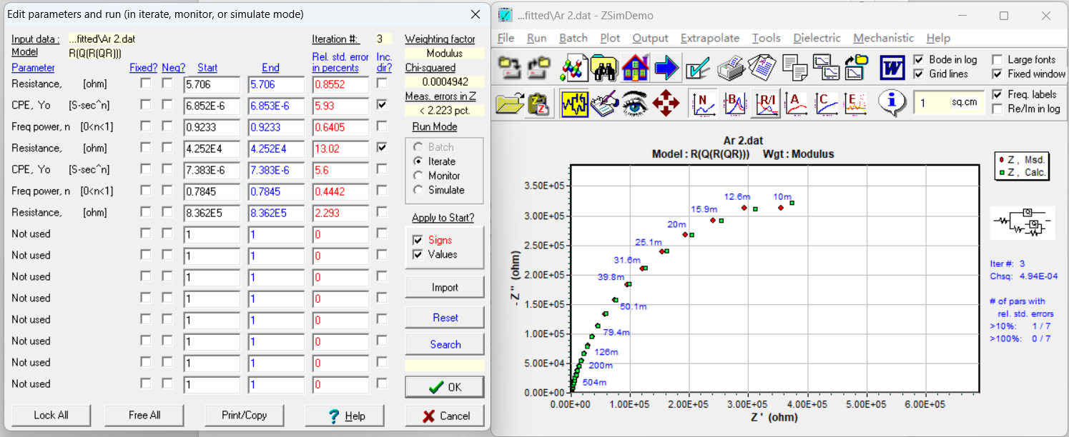

Slide 4
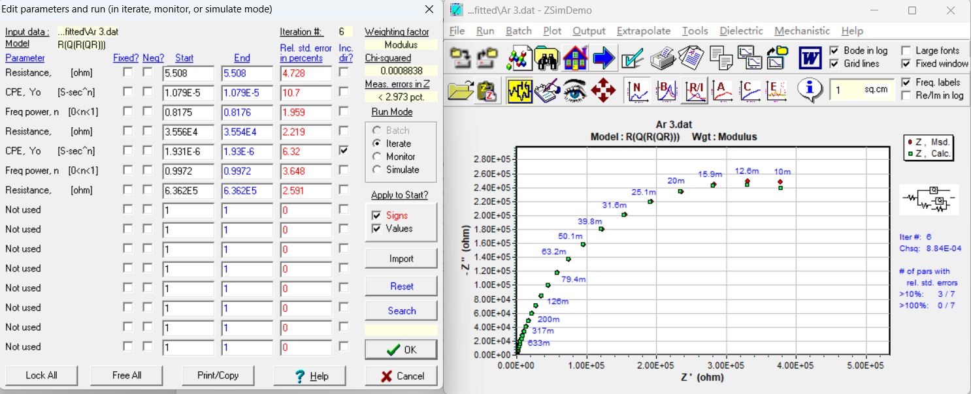

Slide 5
 |  |  |  | Mo-Ar
Samples | R_{s} (Ω·cm²) | CPE_{f} (10⁻⁵· Ω⁻¹ cm⁻² s^{n}) | n_{f} | R_{f} (10⁴ Ω·cm²) | CPEdl (10⁻⁵ Ω⁻¹ cm⁻² s^{n}) | n_{dl} | R_{ct} (10⁴ Ω·cm²) | W (10⁻⁵ Ω·cm² s^{1/2}) | Chi-Squared (×10⁻³)
Ar2 | 5.706 | 0.6853 | 0.923 | 4.252 | 0.7383 | 0.785 | 83.62 | —— | 0.494
Ar3 | 5.508 | 1.079 | 0.818 | 3.554 | 0.193 | 0.997 | 63.62 | —— | 0.8838
average | 5.607 | 0.88215 | 0.8705 | 3.903 | 0.46565 | 0.891 | 73.62 | #DIV/0! | 5.424
standard bar | 0.099 | 0.19685 | 0.0525 | 0.349 | 0.27265 | 0.106 | 10 |  | 0.1949
 |  |  |  | Pure Mo
Samples | R_{s} (Ω·cm²) | CPE_{f} (10⁻⁵· Ω⁻¹ cm⁻² s^{n}) | n_{f} | R_{f} (10⁴ Ω·cm²) | CPEdl (10⁻⁵ Ω⁻¹ cm⁻² s^{n}) | n_{dl} | R_{ct} (10⁴ Ω·cm²) | W (10⁻⁵ Ω·cm² s^{1/2}) | Chi-Squared (×10⁻³)
Non-irradiated Mo | 3.56 | 5.15 | 0.78 | 1.6 | 3.14 | 0.89 | 2.55 | 1.32 | 6.33
1# | 3.783 | 13.33 | 0.954 | 2.298 | 42.52 | 0.867 | 5.065 | 1.7 | 4.518
average | 3.6715 | 9.24 | 0.867 | 1.949 | 22.83 | 0.8785 | 3.8075 | 1.51 | 5.424
error | 0.05575 | 2.045 | 0.0435 | 0.1745 | 9.845 | 0.00575 | 0.62875 | 0.095 | 0.45

